Slide 1
Introduction to ABC
Presenter: Shuo-Ren Lin
Instructor: Jie-Hong Roland Jiang

Slide 2
Outline
Introduction
Basic data structure
Command summary
Customize ABC
Case study

Slide 3
Introduction
A growing software system for synthesis and verification of binary sequential logic circuits appearing in synchronous hardware designs

Slide 4
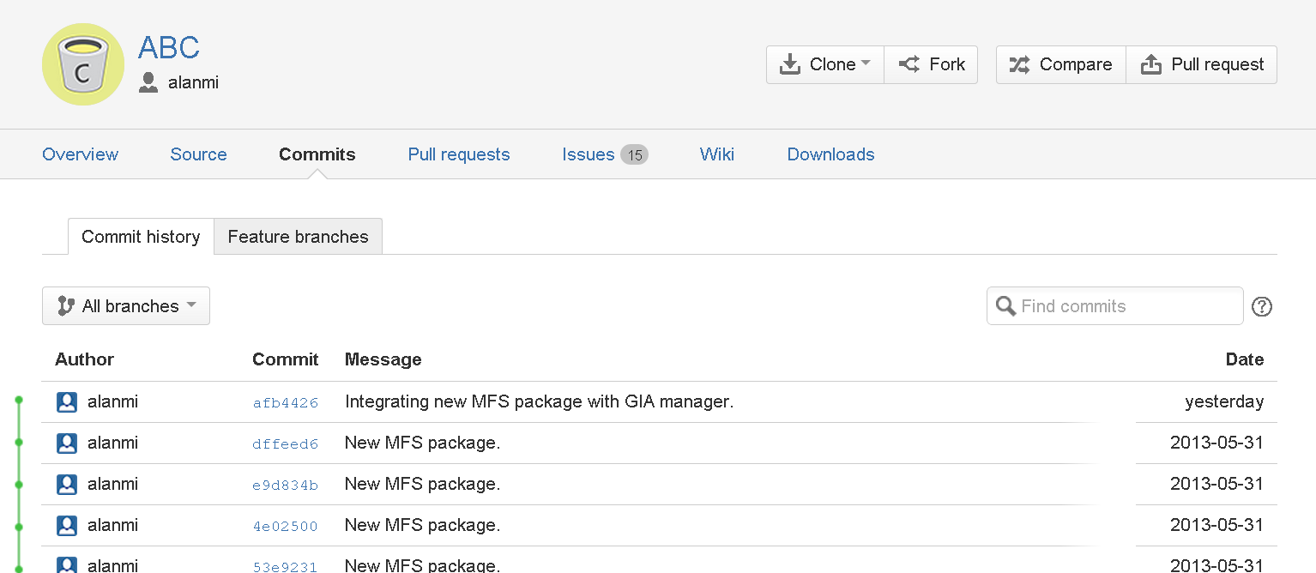
Growing?

Slide 5
Basic Data Structure
Type vs. functionality
http://www.eecs.berkeley.edu/~alanmi/abc/programming.pdf
Type/Functionality | SOP | BDD | AND2 | Gates
Netlist | X |  | X | X
Logic network | X | X | X | X
AIG |  |  | X

Slide 6
Netlist
Nets, logic nodes, latches, PIs, and POs
A node can be represented using SOP or AIG, or gate from standard cell library
APIs (refer to abc.h)
  Abc_NtkAlloc
  Abc_NtkCreatePi, Abc_NtkCreatePo
  Abc_NtkFindOrCreateNet
  Abc_NtkCreateNode, Abc_NtkCreateLatch
  Abc_ObjAddFanin
  Abc_NtkFinalizeRead, Abc_NtkCheck
Notes:
Abc_Ntk_t * Abc_NtkAlloc( Abc_NtkType_t Type, Abc_NtkFunc_t Func, int fUseMemMan );
Abc_Obj_t * Abc_NtkCreatePi( Abc_Ntk_t * pNtk )
Abc_NtkFindOrCreateNet( Abc_Ntk_t * pNtk, char * pName );
Abc_NtkFinalizeRead( Abc_Ntk_t * pNtk );

Slide 7
Logic Network
A netlist, and the nets have been removed
Only PI/PO/latch/latch-input/latch-out names are saved (eliminate names of internal nodes)
APIs
  Abc_NtkStartFrom
  Abc_NtkForEachPi, Abc_NtkForEachCi, …
  Abc_ObjPatchFanin, Abc_ObjTransferFanout

Slide 8
AIG
Only contain 2-inputs AND and each fanin/fanout edge has an optional complemented attribute
APIs
  Abc_AigAnd, Abc_AigOr, Abc_AigXor, …
  Abc_AigReplace

Slide 9
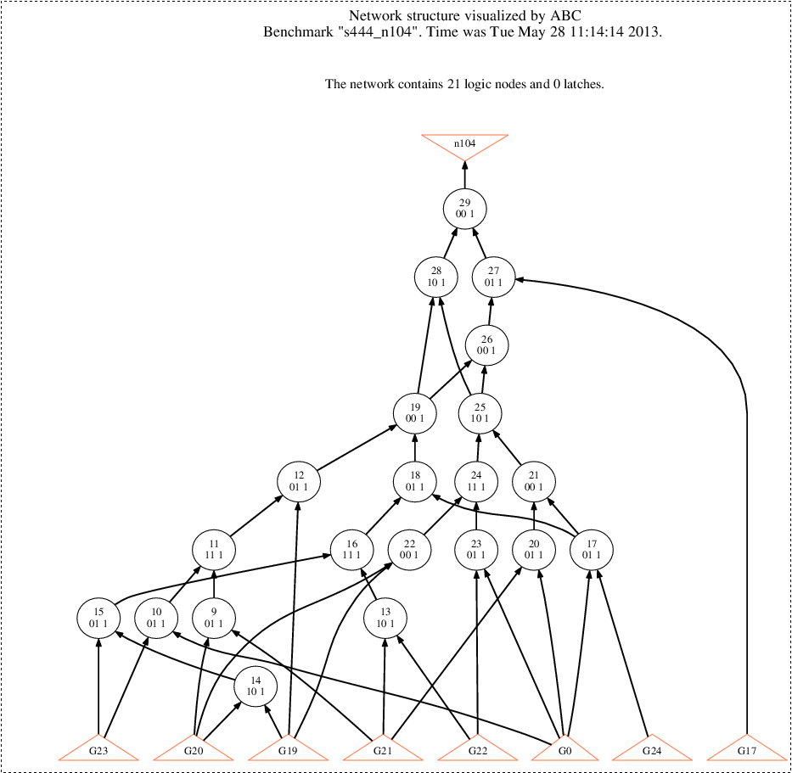
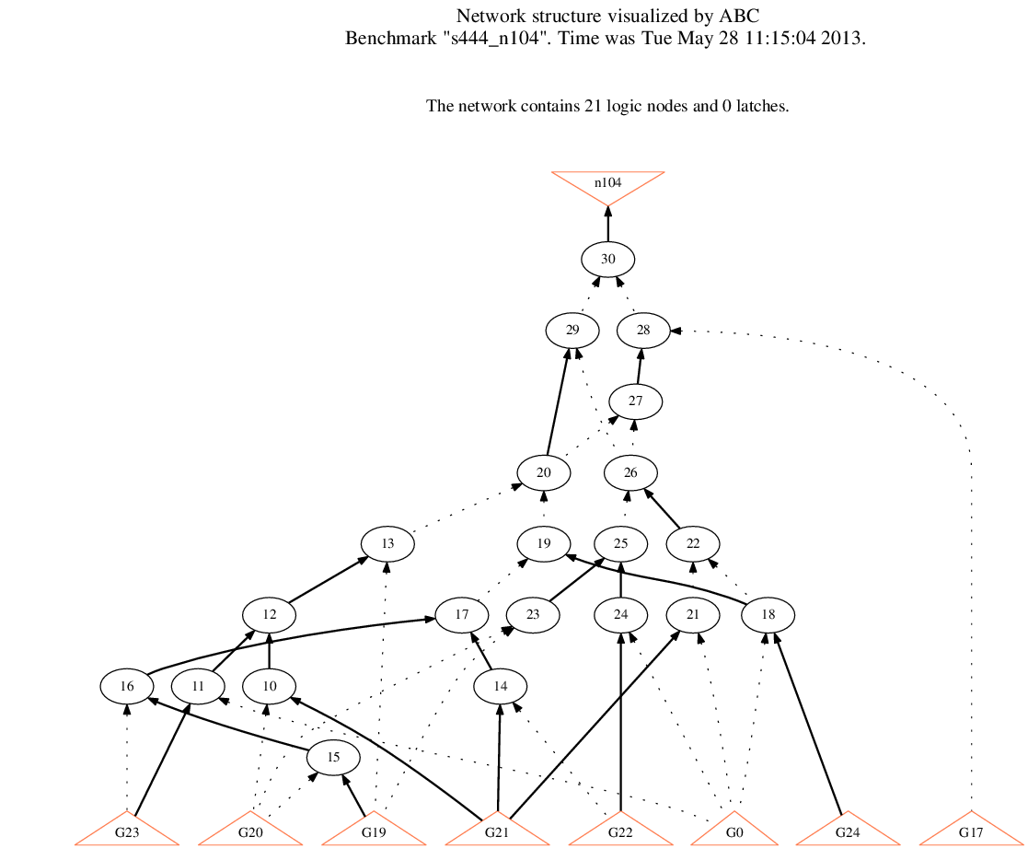
Logic Network vs. AIG

Slide 10
Command Summary

Slide 11
Command Summary -- Read
read_verilog
  Support very limited subset of structural Verilog
read_blif
  http://www1.cs.columbia.edu/~cs4861/s07-sis/blif/index.html
read_aiger, read_bench, …

Slide 12
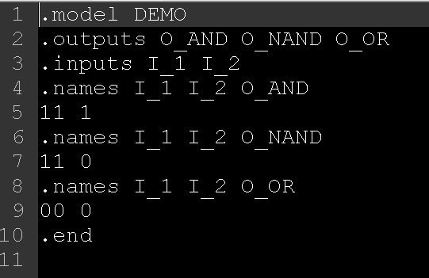
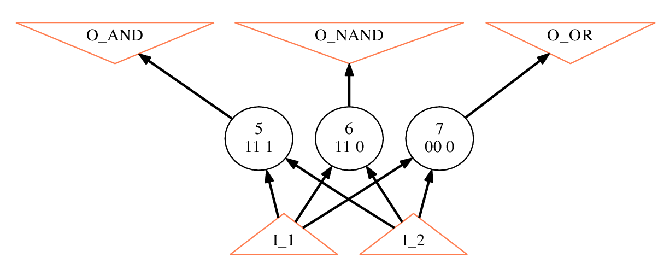
Blif File Sample

Slide 13
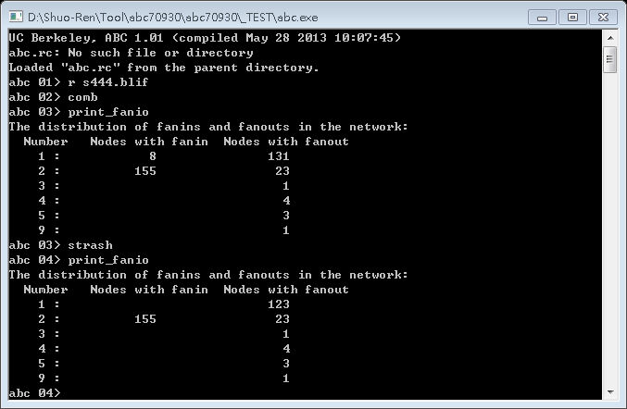
Command Summary -- Print
print_fanio

Slide 14
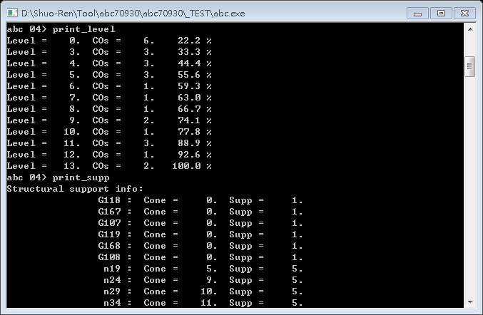
Command Summary -- Print
print_level, print_supp

Slide 15
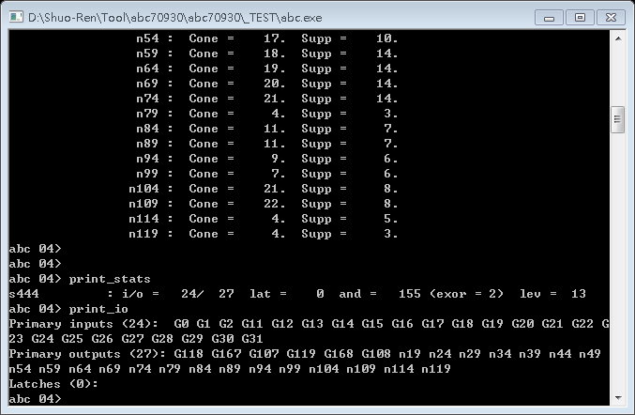
Command Summary -- Print
print_io, print_stats

Slide 16
Command Summary --
Comb. Synthesis
Combinational synthesis
  AIGs
    balance, refactor, rewrite, rr, renode, strash(structure hash)
  BDDs
    dsd, collapse
  Logic network
    cleanup, sweep

Slide 17
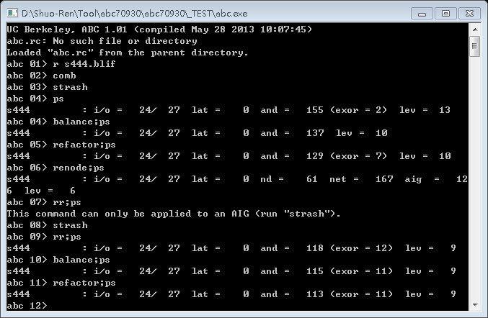
Command Summary --
Comb. Synthesis

Slide 18
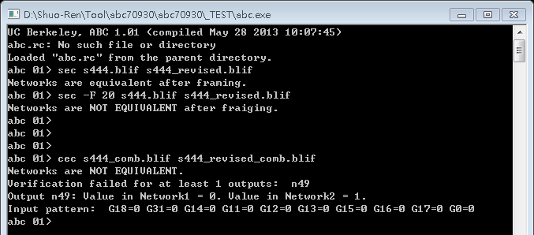
Command Summary -- Verification
cec, sec, sat

Slide 19
Command Summary -- Show
show
  #node < 300
  Install other software
    GSview
      Program for opening PostScript files
      http://pages.cs.wisc.edu/~ghost/gsview/
    GhostScript
      Necessary script for Gsview
      http://pages.cs.wisc.edu/~ghost/doc/GPL/
    Graphvis
      Program for generate PostScript files
      http://www.graphviz.org/

Slide 20
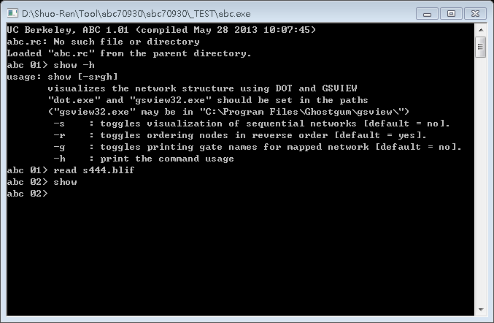
Command Summary -- Show

Slide 21
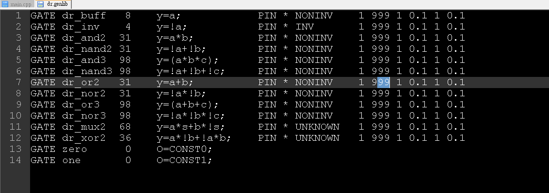
Command Summary --
Tech. Mapping
map
  Need genlib file (use command read_library)
    Format: http://www.ece.cmu.edu/~ee760/760docs/genlib.pdf

Slide 22
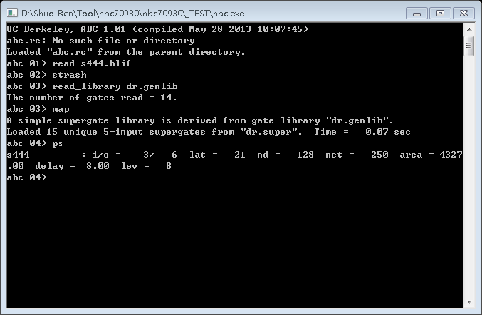
Command Summary --
Tech. Mapping

Slide 23
Customize ABC

Slide 24
Customize ABC
Three Steps
  Declare command in abc.c
  Implement command
  Register command in function Abc_Init (in abc.c)

Slide 25
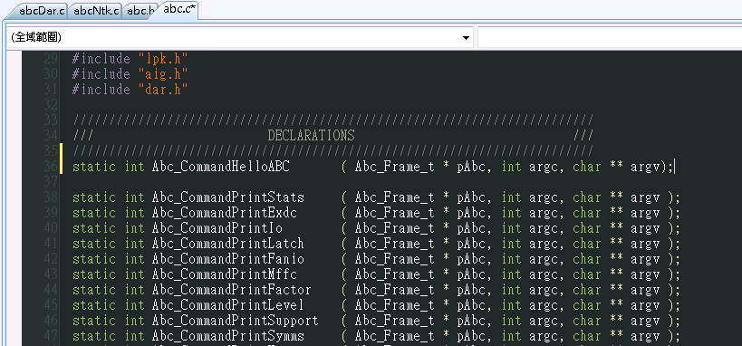
Customize ABC: Step1

Slide 26
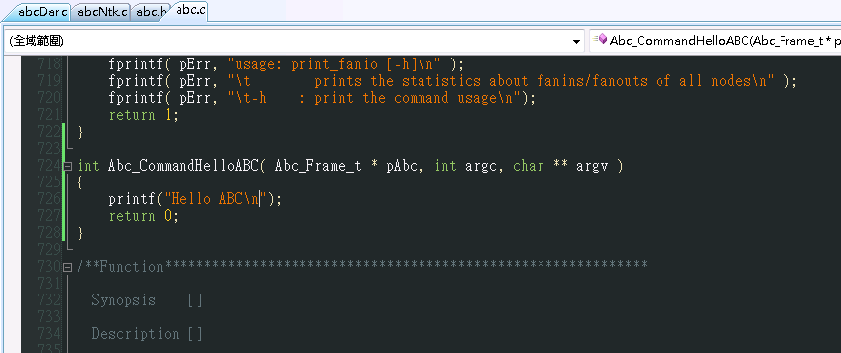
Customize ABC: Step2

Slide 27
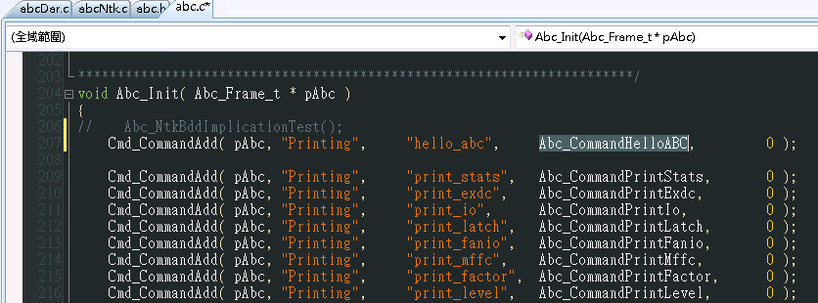
Customize ABC: Step3

Slide 28
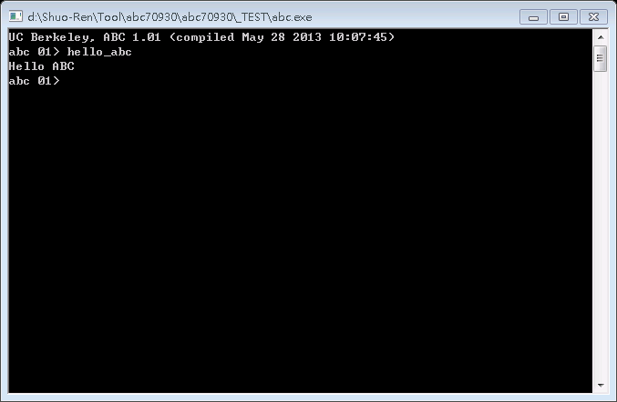
Customize ABC: Finish

Slide 29
Case Study: print_symmetry
Count symmetry input pair for each prime output
Use incremental SAT solving
Check the symmetry between x and y
(ctrl + a + b) * (…
≠
x
y
x
y

Slide 30
Basic Structure
void Symmetry( Abc_Ntk_t * pNtk )
{
  Abc_Ntk_t * pNtk_temp;
  Abc_Obj_t * pCo;
  int i;
  Abc_NtkMakeComb( pNtk, 0);
  Abc_NtkForEachCo( pNtk, pCo, i) {
    pNtk_temp = Abc_NtkCreateCone( pNtk, Abc_ObjFanin0(pCo), Abc_ObjName(pCo), 0);
    pNtk_temp = Abc_NtkStrash( pNtk_temp, 0, 0, 0);
    //Compute Symm_CO
    nTotalSymm += Symm_CO;
  }
  printf("Total symmetry: %d\n",nTotalSymm);
}
pCo
pNtk
Notes:
Abc_Ntk_t * Abc_NtkCreateCone( Abc_Ntk_t * pNtk, Abc_Obj_t * pNode, char * pNodeName, int fUseAllCis );
Abc_Ntk_t * Abc_NtkStrash( Abc_Ntk_t * pNtk, int fAllNodes, int fCleanup, int fRecord );

Slide 31
Construct AIG Circuit
pAig1 = (Aig_Man_t *) Abc_NtkToDar( pNtk_temp, 0, 0);
pAig2 = (Aig_Man_t *) Abc_NtkToDar( pNtk_temp, 0, 0);
pPi1 = ABC_ALLOC( Aig_Obj_t* , Aig_ManPiNum(pAig1));
pPi2 = ABC_ALLOC( Aig_Obj_t* , Aig_ManPiNum(pAig2));
pAig = Aig_ManStart( Aig_ManObjNumMax(pAig1) + Aig_ManObjNumMax(pAig2) );
// adding aig1 to aig
Aig_ManConst1(pAig1)->pData = Aig_ManConst1(pAig);
Aig_ManForEachPi( pAig1, pObj, j ) {
pObj->pData = Aig_ObjCreatePi( pAig );
pPi1[j] = pObj->pData;
}
Aig_ManForEachNode( pAig1, pObj, j )
pObj->pData = Aig_And( pAig, Aig_ObjChild0Copy(pObj), Aig_ObjChild1Copy(pObj) );
// adding aig2 to aig
// same as previous part
//building exor miter
pObj = Aig_Exor( pAig, Aig_ObjChild0Copy(Aig_ManPo(pAig1,0)),Aig_ObjChild0Copy(Aig_ManPo(pAig2,0)) );
Aig_ObjCreatePo( pAig, pObj );
Aig_ManCleanup(pAig);
xor
pAig1
pAig2
Notes:
Aig_Man_t * Abc_NtkToDar( Abc_Ntk_t * pNtk, int fExors, int fRegisters );
Aig_Man_t * Aig_ManStart( int nNodesMax );
Aig_Obj_t * Aig_ObjChild0Copy( Aig_Obj_t * pObj )
Aig_Obj_t * Aig_ManPo( Aig_Man_t * p, int i )

Slide 32
Initialize CNF Manager
nProblem = (Aig_ManPiNum(pAig1) - 1) * Aig_ManPiNum(pAig1) / 2;
nLiterals = 1 + 7 * Aig_ManNodeNum(pAig) + Aig_ManPoNum(pAig) + 3 + nProblem * ( 8 + (Aig_ManPiNum(pAig1) - 2) * 6);
nClauses = 1 + 3 * Aig_ManNodeNum(pAig) + Aig_ManPoNum(pAig) + 1 + nProblem * ( 4 + (Aig_ManPiNum(pAig1) - 2) * 2);
pCnf = ABC_ALLOC( Cnf_Dat_t, 1 );
memset( pCnf, 0, sizeof(Cnf_Dat_t) );
pCnf->pMan = pAig;
pCnf->nLiterals = nLiterals;
pCnf->nClauses = nClauses;
pCnf->pClauses = ABC_ALLOC( int *, nClauses + 1 );
pCnf->pClauses[0] = ABC_ALLOC( int, nLiterals );
pCnf->pClauses[nClauses] = pCnf->pClauses[0] + nLiterals;
pCnf->pVarNums = ABC_ALLOC( int, Aig_ManObjNumMax(pAig) + nProblem );

Slide 33
Assign Variable
for( l = 0 ; l < Aig_ManObjNumMax(pAig) + nProblem ; l++ )
  pCnf->pVarNums[l] = -1;
Number = 1;
Aig_ManForEachPo( pAig, pObj, m)
pCnf->pVarNums[pObj->Id] = Number++;
Aig_ManForEachNode( pAig, pObj, m)
pCnf->pVarNums[pObj->Id] = Number++;
Aig_ManForEachPi( pAig, pObj, m)
pCnf->pVarNums[pObj->Id] = Number++;
pCnf->pVarNums[Aig_ManConst1(pAig)->Id] = Number++;
l = 0;
CtrlVar = ABC_ALLOC( int , nProblem);
for( m = 0 ; m < Aig_ManObjNumMax(pAig) + nProblem ; m++) {
if(pCnf->pVarNums[m] == -1) {
CtrlVar[l] = m;
l++;
pCnf->pVarNums[m] = Number++;
}
}
pCnf->nVars = Number;
3
2
4
5
1

Slide 34
Add Clauses of Nodes(ANDs)
m = 0;
Aig_ManForEachNode( pAig, pObj, m ) {
OutVar = pCnf->pVarNums[ pObj->Id ];
pVars[0] = pCnf->pVarNums[ Aig_ObjFanin0(pObj)->Id ];
pVars[1] = pCnf->pVarNums[ Aig_ObjFanin1(pObj)->Id ];
// positive phase
*pClas++ = pLits;
*pLits++ = 2 * OutVar;
*pLits++ = 2 * pVars[0] + !Aig_ObjFaninC0(pObj);
*pLits++ = 2 * pVars[1] + !Aig_ObjFaninC1(pObj);
// negative phase
*pClas++ = pLits;
*pLits++ = 2 * OutVar + 1;
*pLits++ = 2 * pVars[0] + Aig_ObjFaninC0(pObj);
*pClas++ = pLits;
*pLits++ = 2 * OutVar + 1;
*pLits++ = 2 * pVars[1] + Aig_ObjFaninC1(pObj);
}
Var. number
sign
Notes:
Skip PI and PO constraints

Slide 35
Incremental SAT-Solving
pCtrl = ABC_ALLOC( lit , nProblem + 1);
nTotalSymm_Po = 0;
for( iProblem = 0 ; iProblem < nProblem ; iProblem++) {
for( m = 0 ; m < nProblem ; m++ ) {
if( m == iProblem ){
pCtrl[m] = lit_read((-1) * (pCnf->pVarNums[ CtrlVar[m] ] + 1));
}
else {
pCtrl[m] = lit_read((pCnf->pVarNums[ CtrlVar[m] ] + 1));
}
}
pSat = (sat_solver *)Cnf_DataWriteIntoSolver( pCnf, 1, 0);
if( pSat == NULL ) printf("WARNING SAT SOLVER IS NULL!\n");
stats = sat_solver_solve(pSat, &pCtrl[0], &pCtrl[nProblem], 10000000, 10000000, 0, 0);
if( stats == l_False ) nTotalSymm_Po++;
}

