Slide 1
Enigma Machine
Team Name: team13
Programmer: 陳則凱 b99605005
Tester: 劉典恆 b01901185

Slide 2
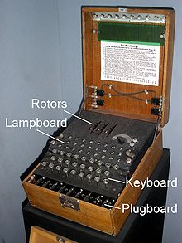
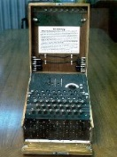
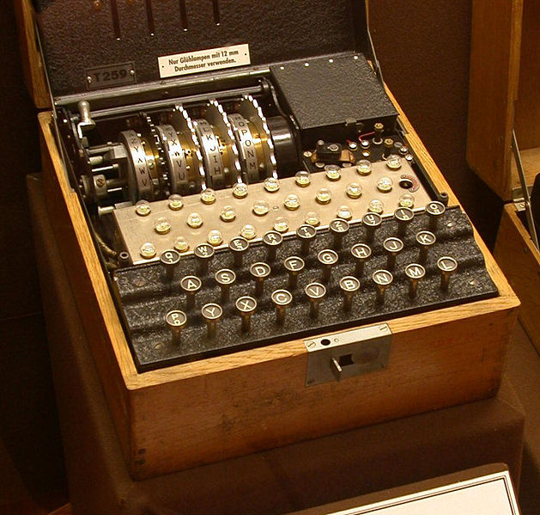
What is Enigma Machine?
An Enigma machine is a electro-mechanical rotor cipher machines used for the encryption and decryption of secret massages.

Slide 3
Some History (1)
In World War II, the Nazi military employed an encryption scheme that addressed the weakness of substitution ciphers.
The scheme, implemented by typewriter sized devices known as Enigma machines, gave the Nazis a tactical advantage that greatly contributed to their early success in the war.

Slide 4
Some History (2)
Efforts to break the Enigma code led to the development of the first electronic computers at Bletchley Park, England: the Bombe (designed by Alan Turing) and its successor, Colossus (designed by Tommy Flowers).
Using computers, the Allies were eventually able to break the Enigma code, giving them an intelligence edge that changed the balance of the war.

Slide 5
What do we want to do?
We want to write a program to simulate the Enigma machine.
Extra: Try to write a program to decrypt the secret code produced by the Enigma machine.

Slide 6
Why is it worth doing?
Cryptography has played an important role in the history of computing, from motivating the development of the first electronic computer to enabling secure Web-based communication and commerce. This program enable us to know the role of encryption in military and computing history, and have a deep look into the mechanism of Enigma machine.
The needs of data protection.

Slide 7
How It Works? The Basic Idea (1)
The Caesar Cipher
Each letter in the alphabet would be encoded using the letter n position later in the alphabet.
Example: When n = 3,
a b c d e f → d e f g h i
Weakness: The pattern is too regular, easy to break the code.

Slide 8
How It Works? The Basic Idea (2)
Substitution Ciphers
A code in which one letter of the alphabet is substituted for another (in random).
Example: a b c d e f → h j a s d b
Weakness: Not all letters are equally likely in text, so the relative frequency of characters in the coded message can provide clues for decoding.

Slide 9
How It Works? The Basic Idea (3)
Rotating Ciphers
After each letter is encoded, the key is rotated so that the first character is moved to the end.
Example: a b c d e f → h j a s d b
encode: a a a → h j a
encode: a b c → h a d

Slide 10
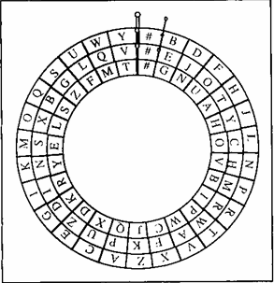
How It Works? The Basic Idea (4)
A Simple Enigma Model
It is a combination of three rotating rotor (wheel).
The inner rotor rotate one step after every single character is encrypted.
The middle rotor rotate one step after the inner rotor complete a round of rotation.
Same for the outer rotor.

Slide 11
How It Works? The Basic Idea (5)
To encrypt a character,
Find the character on the inner rotor
Note the corresponding character on the outer ring
Find that character on the middle rotor
Output the corresponding character on the outer ring.
Reverse procedure to decrypt the message.

Slide 12
How It Works? The Basic Idea (6)
Enigma machine paper model
Consisting of three rotor, each with a notch on it, a spindle with a reflector on it.
The rotor are filled with alphabet.
The spindle has an setting line.
(refer to the DIY Enigma machine)

Slide 13
How It Works? The Basic Idea (7)
The variance
Three rotor can be put in any order.
Each rotor can start with any character.
Each notch can be replaced.

Slide 14
Classes Structure
EnigmaMachine
Rotor
Reflector

Slide 15
Class EnigmaMachine
Data Member:
Rotor r1, r2, r3
Reflector r
Member Function:
Check and rotate
Input and output
Setting the arrangement of the three rotor

Slide 16
Class Rotor
Data Member:
char charArray[27]
int notchLocation
int startingPoint
Member function:
Rotate
Set notch location
Set starting point
Mapping
Input and output

Slide 17
Class Reflector
Data member
Member function
Input and Output
mapping

Slide 18
Control flow - EnigmaMachine
Read a character
process
Return a character
Check and rotate

Slide 19
Control flow - Process
Input panel
Rightmost rotor
Middle rotor
Leftmost rotor
Reflector
Leftmost rotor
Middle rotor
Rightmost rotor
Output panal

Slide 20
Control flow – Rotor / Reflector
Input
Mapping
Output

Slide 21
Control Flow – Check and Rotate
Check rotor r1, get notch position
Check rotor r2, get notch position
Check rotor r3, get notch position
Rotate depends on condition

Slide 22
How To Test? Test Plan
For the entire class EnigmaMachine, use it to encrypt an entire passage, then decrypt it.
Develop code breaking programs for the Caesar cipher, Substitute cipher, Rotating cipher, and try them on the code encrypt by Enigma machine.

Slide 23
Some Features can be Added
Replace the 26 alphabets and a space with ASCII table
Graphical user interface design
Upgrade to 4-rotor Enigma machine

Slide 24
Thank you

