Slide 1
圖像辨識系統開發
暨及其位於行動裝置上之運用
B99901050
電機三
陳敬元
Proposal. 2013/3/27

Slide 2
Abstract
利用單一、亦或多種搭配使用之演算法，以擷取取圖像之特徵(feature)，並與資料庫進行比對以取回目標資料。

Slide 3
Outline
Application
Implement
Schedule

Slide 4
Outline
Application
Implement
Schedule

Slide 5
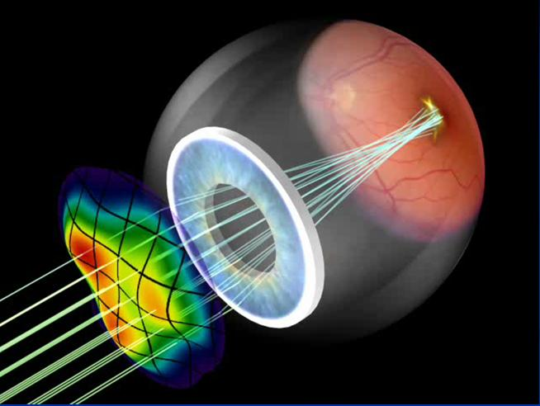

Application

Slide 6
Application
圖像檢索
Security

Slide 7
Outline
Application
Implement
Schedule

Slide 8
Outline
Application
Implement
Schedule

Slide 9
Implement
Specification: Image Shortcut
Feature Extraction
Indexing
User Interference

Slide 10
Outline
Application
Implement
Schedule

Slide 11
Outline
Application
Implement
Schedule

Slide 12
Schedule
3/5 Team Registration.
3/27 Proposal.
4/27 Feature Extraction
5/1 Mid-term project report.
5/12 Indexing
6/9 UI
6/11 Final presentation.

Slide 13
Schedule
3/5 Team Registration.
3/27 Proposal.
4/27 Feature Extraction
5/1 Mid-term project report.
5/12 Indexing
6/9 UI
6/11 Final presentation.

Slide 14
The End.
Thanks for Your Listening: )

