Slide 1
論文實例 3：論文資料
Context-Aware Cloud Robotics for Material Handling
in Cognitive Industrial Internet of Things
Jiafu Wa, Shenglong Tang, Qingsong Hua, Di Li, Chengliang Liu, and Jaime Lloret
IEEE Internet of Things Journal, Vol. 5, No. 4, August 2018
Abstract
In the context of Industry 4.0, industrial robotics such as automated guided vehicles have drawn increased attention due to their automation capabilities and low cost. With the support of cognitive technologies for industrial Internet of Things (IoT), production processes can be signiﬁcantly optimized and more intelligent manufacturing can be implemented for smart factories. In this paper, for advanced material handling, a cognitive industrial entity called context-aware cloud robotics (CACR) are introduced and analyzed. Compared with the one-time on-demand delivery, CACR is characterized by two features: 1) context-aware services and 2) effective load balancing. First, the system architecture, advantages, challenges, and applications for CACR are introduced. Then, fundamental functions for material handling are articulated, namely, decision-making mechanisms and cloud-enabled simultaneous localization and mapping. Finally, a CACR case study is performed to highlight its energy-efﬁcient and cost-saving material handling capabilities. Simulations indicate the superiority of cognitive industrial IoT and show that using CACR for material handling can signiﬁcantly improve energy efﬁciency and save cost.
Keywords: Cloud computing, context awareness, industrial wireless networks (IWNs), Industry 4.0, manufacturing execution system, material handling, robotics.
By 連豊力，台大電機，11/27/18

Slide 2
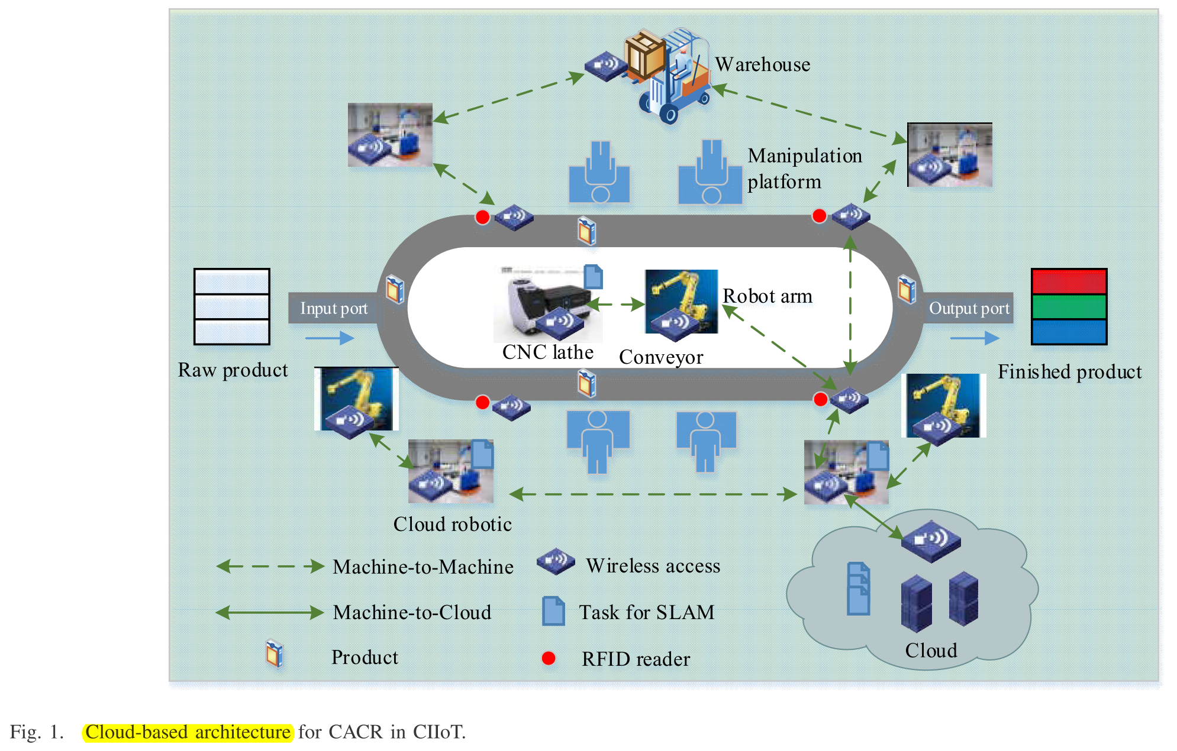
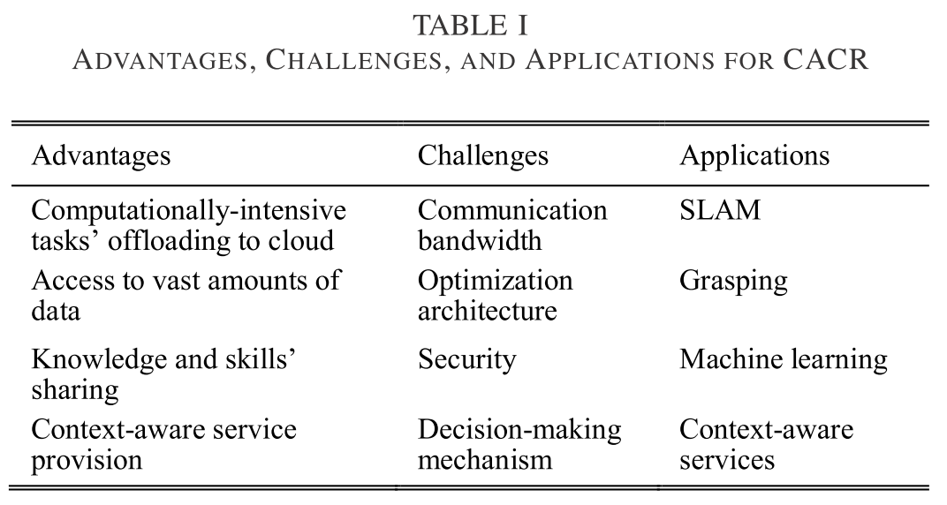
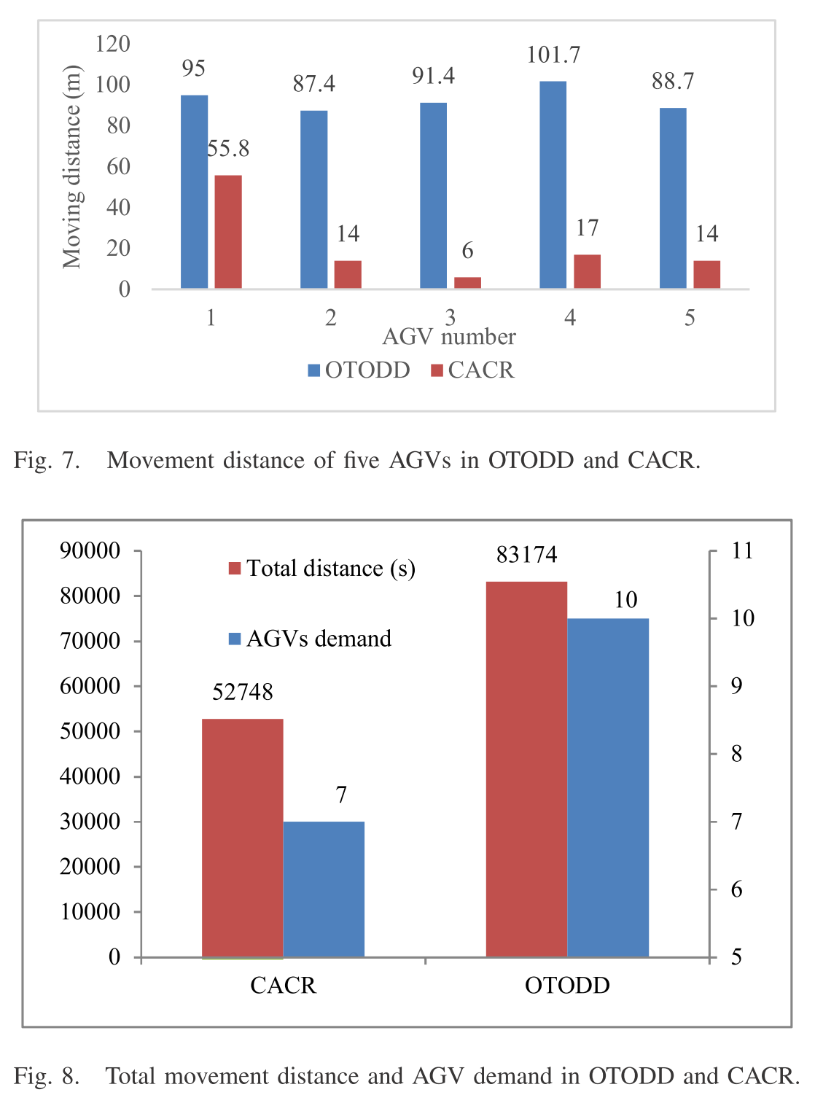
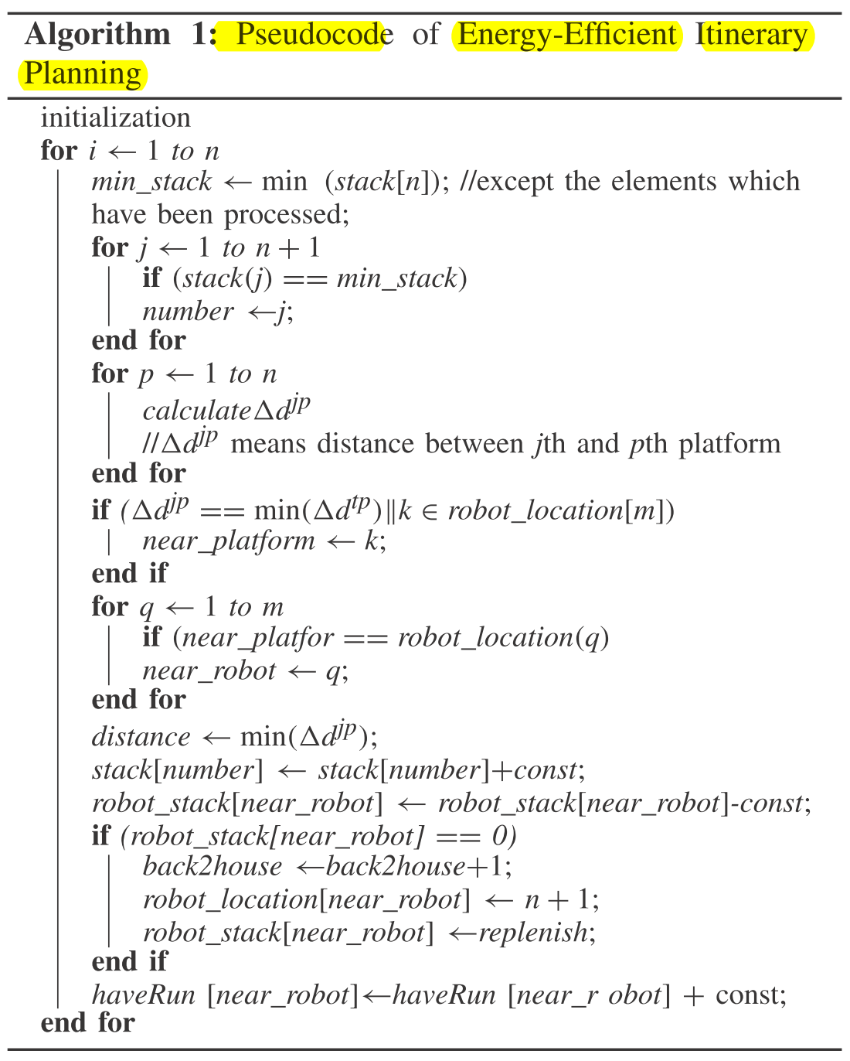
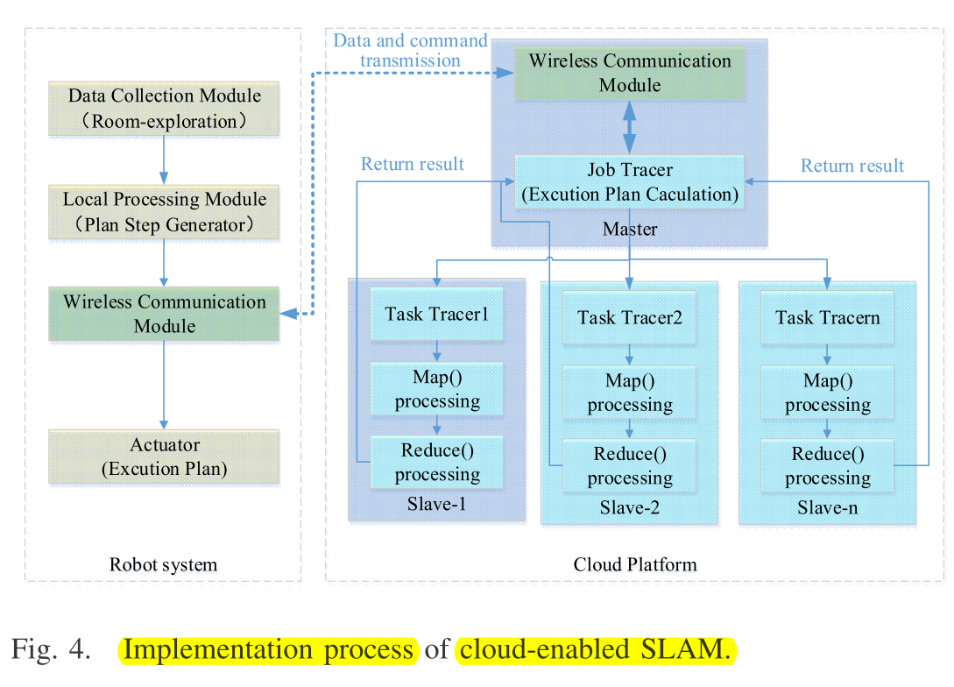
論文實例 3：重要圖表
By 連豊力，台大電機，11/27/18

Slide 3
論文實例 3：資料分析
Scenarios
  Cloud Robotics: CACR, context-aware cloud robotics
  Smart Factory
  Manufacturing
  IIOT: Industrial Internet of Things
Tasks
  Material Handling
  Convey System
  Mobile Robotics
Techniques
  Cloud-enabled SLAM
  Decision Making
  Itinerary Planning
    energy-efﬁcient
    cost-saving
By 連豊力，台大電機，11/27/18

Slide 4
論文實例 1：論文資料
Development of a Home Service Robot 'ISSAC'
Y. Bum-Jae, M. Hwangbo, L. Sung-On, Y. Do Kwon, and S. Lim
IEEE/RSJ International Conference on Intelligent Robots and Systems, Vol. 3, Las Vegas, NV, United States, pp. 2630-2635, Oct. 27-31 , 2003.
Abstract
Human friendly service robots such as home service robots, cleaning robots, entertainment robots take great attention in order to create new markets for robots since the markets for conventional industrial robots are saturating. It is a step to change the working environments of robots from industries to homes and offices, and to extend markets for robots from industrial markets to commercial home appliance markets.
This paper introduces a home service robot 'ISSAC' applicable for vacuum cleaning, home security to find intruders and to transfer captured images of the intruder to the police or security companies, voice-based information service, real-time image transfer through wireless TCP/IP Ethernet and/or CDMA-2000 wireless communication, and a telepresence controllable by mobile computers such as pocket PC's and/or cellular phones. The overall controller is developed as a network-based layered modular controller using CAN (controller area network). The robot is tested in an apartment for a week successfully.
By 彭士瑋，台大電機，1/23/07

Slide 5
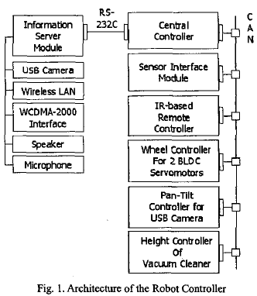
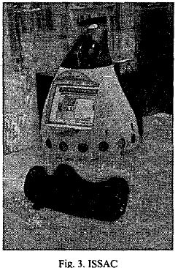
論文實例 1：重要圖表
By 彭士瑋，台大電機，1/23/07

Slide 6
論文實例 1：資料分析
Scenario
  Home Service
    Housekeeping
    Entertainment
    Security
Task
  Vacuum cleaning
  Home security
  Voice-based Information server
  Remote control of home appliances
  Remote control of ‘ISSAC’
Technique
  Motion detection
  Recognize voice
  Wireless communications
  A low-cost localization method and a visual homing approach
  CAN-based networked distributed controller
By 彭士瑋，台大電機，1/23/07

Slide 7
論文實例 2：論文資料
A Multiagent Multisensor Based Real-Time Sensory Control System for Intelligent Security Robot
Ren C. Luo and Kuo L. Su
IEEE International Conference on Robotics & Automation, Taipei, Taiwan, pp. 2394-2399, Sep. 14-19 2003.
Abstract
The security of home, laboratory, office and factory is essential to human daily life. A danger event is often caused by the negligence of humans. Potential hazards may injure our life. Therefore, it motivates us to develop an intelligent multi-sensor based Security Robot system. It is expected to be widely employed in our daily life. Security robot can detect dangerous situation and provide timely alert us. The structure of the security robot contains eight parts. Including remote surveillance and control system, image system, obstacle avoidance system, software system, auto-dialing, driver system, sensor system and motion planning system. In this paper, we discuss the opportunity to use multi-agent technology in the sensory system and the expected improvements. The sensory system has seven-variety detection and diagnosis agent (local agent) and one sensor agent (auxiliary agent). Finally, we use multi-processor architecture to implement the multi-agent based sensory system for the security robot application.
By 葉上瑋 ，台大電機，1/23/07

Slide 8
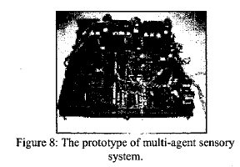
論文實例 2：重要圖表
By 葉上瑋 ，台大電機，1/23/07

Slide 9
論文實例 2：資料分析
Scenario
  There will be some danger events often caused by the negligence of people in daily life. The security robots can detect the dangerous situation and alert people.
Task
  Fire detection/ diagnosis.
  Intruder detection/ diagnosis.
  Environment detection/ diagnosis.
  Obstacle detection agent.
  Motor detection agent.
  Power detection/ prediction.
  Auxiliary agent.
Technique
  Adaptive fusion method.
  Fault detection/ isolation procedure.
By 葉上瑋 ，台大電機，1/23/07

