Slide 1
2011/10/03
許志明 林意淳

Slide 2



Introduction to Lane-Position Detection
許志明 6/30/10
Lane-Position Detection
Lane-Departure-Warning Systems
Driver-Attention Monitoring Systems
Automated Vehicle-Control Systems
[ 2: McCall and Trivedi 2006]
2
Jun. 30, 2010
Notes:
2

Slide 3



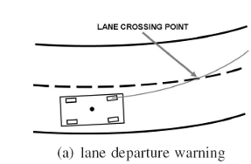
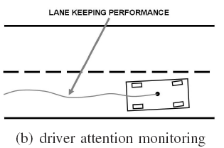
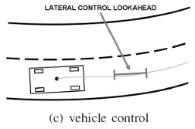
Introduction to Lane-Position Detection
許志明 6/30/10
Lane-Departure-Warning Systems
Driver-Attention Monitoring Systems
Automated Vehicle-Control Systems
3
Jun. 30, 2010
[ 2: McCall and Trivedi 2006]
Notes:
3

Slide 4




Introduction to Lane-Position Detection
許志明 6/30/10
Lane-Position Detection
Lane-Departure-Warning Systems
Driver-Attention Monitoring Systems
Vehicle Surrounding Monitoring Systems
Automated Vehicle-Control Systems
For driver’s information
For automated vehicles
4
Jun. 30, 2010
Notes:
4

Slide 5
Research issues
許志明 9/21/11
Introduction to Road Detection
structured Road
Urban area
Road borders
Road markings
Lane detection
and tracking
Land keeping
Road
Rural area
Without remarkable boundaries and markings
Road detection
Road surface detection
Drivable detection
Branched road detection
Road following
Non-structured Road
Road scene
Static objects
Sky ,Buildings
Tree, Side walks
Traffic sign …
Traffic sign detection
3D Scene identification
Environment perception
Non-Road
Dynamic objects
Vehicles, bicycles
Pedestrian …
Vehicles detection
Bicycles detection
Pedestrian detection

Slide 6

林意淳 6/27/11
Minimum # to reconstruct
Remove redundant information
Information classification
Important
Redundant
Optimal problem
Convex problem
Performance index or constraint
Remove method
Sampling
Periodic
Weighting allocation
Sampling + Weighting
ALL information quantities x δ%
ROI
SNR or PSNR
Error
Weighting
Varying
Temporal sampling + spatial weighting
Information Reduction (Fusion)
Sampling rate
Weighting
Information

Slide 7
NCS
(exp.) Stability (stabilization)
Delay
Tradeoff
Performance
Constant
Random (varying)
Network cost
Topic
Method
LMI
Switched system
Robust stability analysis
Stochastic control theory
Hybrid
MLJS
Markov process
(Discrete)
Linear differential equation
(cont.)
Bounded
Application
Inverted pendulum
Numerical example
Sufficient cond.
Assumption
Delay of ca
# of accessing the network
Computing bounded
Lyapunov-based
Stability analysis
Stability analysis
Guarantee stability
林意淳 4/12/11

Slide 8
林意淳 4/12/11
Control
Communication
Known QoS
bandwidth
transmission rate
Known QoC
robustness
delay
etc
etc
dropouts
stability
[Yepez et al. 2002]
[Dritsas et al. 2009]
[Heemels et al. 2009]
[Chen et al. 2009]
[Lian et al. 2003]

